Slide 1

Week 6 1. Concurrency in Java (cont.)
Dr. Andreas S. Maniatis
Assistant Professor
School of Computer Science
COMP.2800 – Software Development [2026W]
Monday, February 9th, 2026 | 14:30 – 15:50 | ER 1118

Slide 2



Concurrency in Java (cont.)
Dr. Andreas Maniatis
Assistant Professor

Slide 3
Agenda
Hello, World!
The rules of the game
Working with Swing Components
The humble dialog
Decoupling the view from the application logic
Notes:
Introduce Swing as Java’s primary desktop GUI framework. Emphasize relevance to second-year students building real applications.

Slide 4

Agenda
Concurrency in Java:
Processes vs. Threads
Multithreading
Lifecycle of a Thread
Thread Priorities

Slide 5
Part I Processes and Threads

Slide 6
What is a Process?

Slide 7
Introduction Unix Processes
Creating a new Process: fork() Terminating a process: exit() wait() and waitpid()
Context
Context
single computer (single CPU)
under UNIX operating system
It is possible to have several simultaneously executing programs
→ It appears that the executions are done in Parallel!
Multiprogramming:
The CPU executes some instructions of one program then switches to another program giving the illusion that any program is continuously executing, this scheme is called time-slicing.

Slide 8
Introduction Unix Processes
Creating a new Process: fork() Terminating a process: exit() wait() and waitpid()
Program vs. process
A program is an executable file residing on a disk.
A process is an executing (running) program, usually with a limited life-time.
Note that sometimes a process is called task.
Important notion
An executing program → a process.

Slide 9
Processes vs Threads

Slide 10
Process vs. Threads
What is the difference between multiple process and multiple threads?

Slide 11
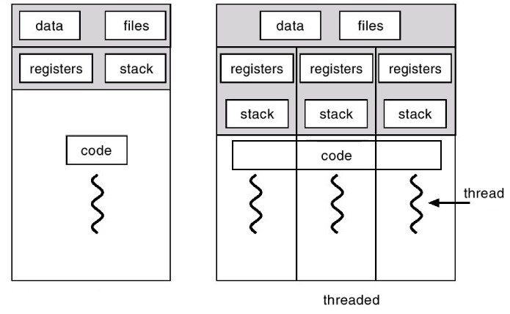
Process vs. Threads
What is the difference between multiple process and multiple threads?
Each process has a complete set of its own variables
Threads share the same data.
Communication between threads is more efficient and easier to program because of shared variables.
Threads are more lightweight than processes.

Slide 12
Multithreading

Slide 13
Why is Multithreading useful?
We can perform multiple tasks at the same time.

Slide 14
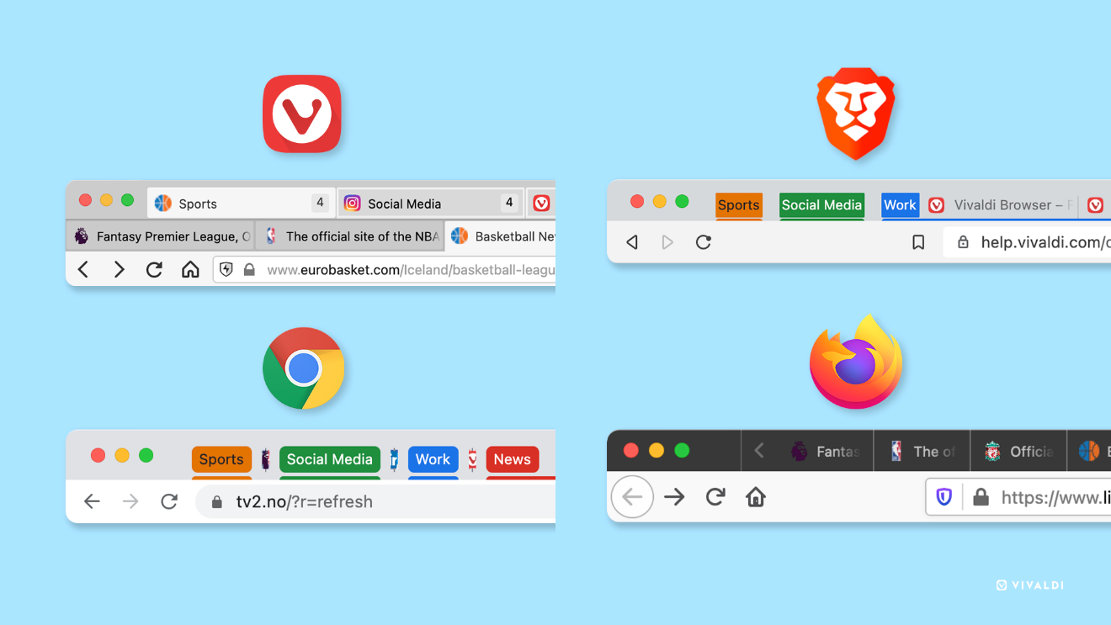
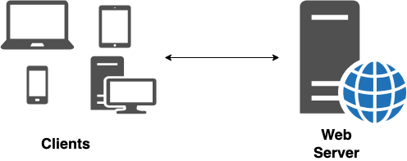
Why is Multithreading useful?
We can perform multiple tasks at the same time.
Example:
A browser can download multiple webpages.
A web server can serve requests coming from different users.
Graphical User Interface programs have a separate thread for collecting user interface events from the host operating system.

Slide 15
Threads

Slide 16
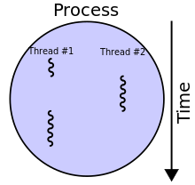
What is a thread?
A thread of execution is the smallest sequence of programmed instructions that can be managed independently by a scheduler, which is typically a part of the operating system.
In many cases, a thread is a component of a process.
The capability of running threads concurrently is called multithreading
Notes:
https://en.wikipedia.org/wiki/Thread_(computing)

Slide 17
Creating a Thread in Java
public interface Runnable {
void run();
}
The Runnable interface describes the tasks you need to run in a thread
Multiple threads can concurrently on different cores or time slices on the same core

Slide 18
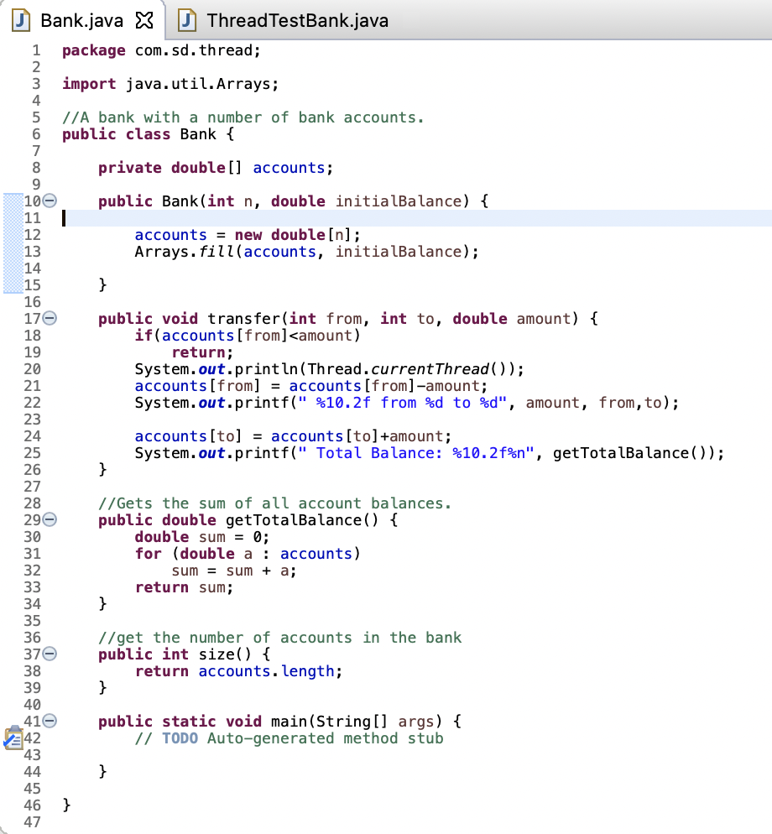
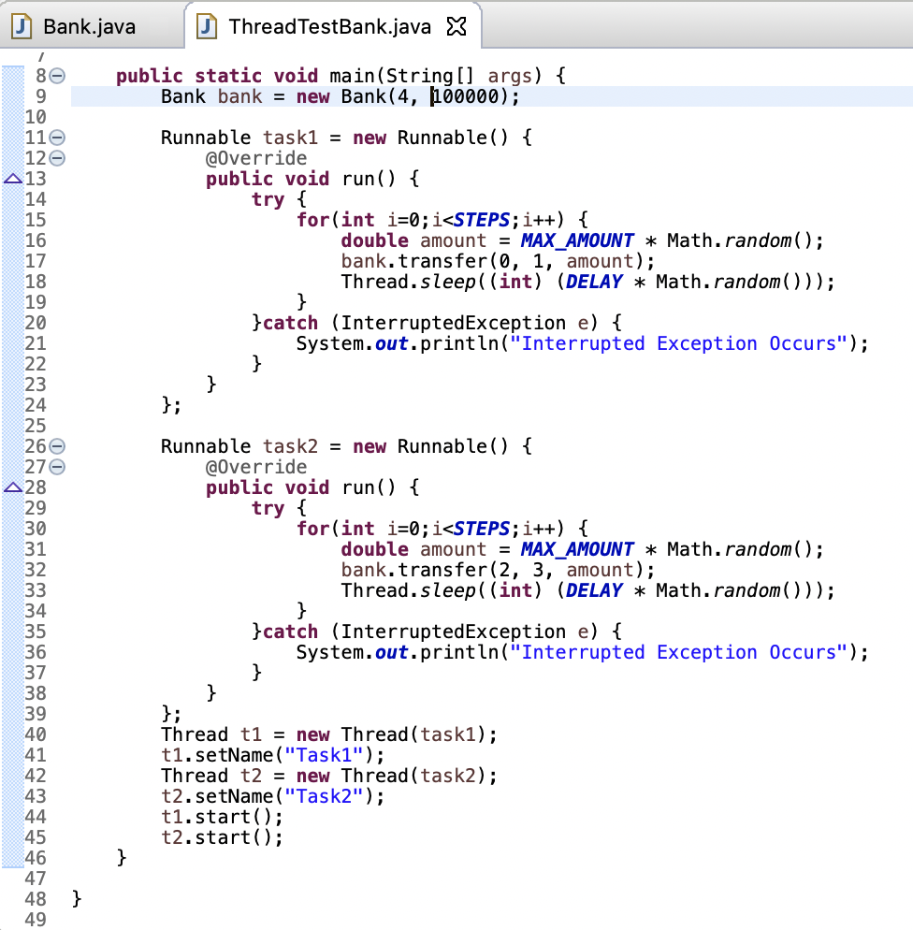
Banking: Concurrency needed
Notes:
Screen Shot 2024-02-07 at 12.16.15 PM.png

Slide 19
Part II The Lifecycle of a Thread

Slide 20
Thread States

Slide 21
Life Cycle of a Thread
A thread can be in one of the six states:
New
Runnable
Blocked
Waiting
Timed Waiting
Terminated

Slide 22
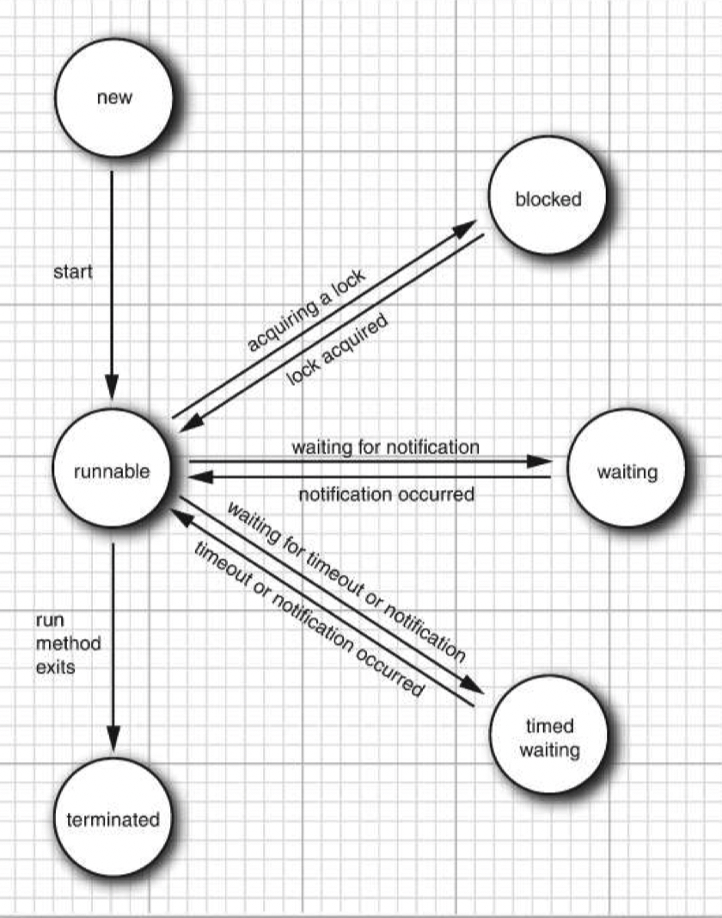
Life Cycle of a Thread
A thread can be in one of the six states:
New
Runnable
Blocked
Waiting
Timed Waiting
Terminated
Thread t = new Thread (…) t.setName(“Task-1”);

Slide 23
Life Cycle of a Thread
A thread can be in one of the six states:
New
Runnable
Blocked
Waiting
Timed Waiting
Terminated
Thread T = new Thread (…) t.setName(“Task-1”)
t.start();
Notes:
A runnable thread may or may not actually be running. It is up to the operating system to give the thread time to run. The Java speciﬁcation does not call this a separate state, though. A running thread is still in the runnable state.
Once a thread is running, it doesn’t necessarily keep running. In fact, it is desirable that running threads occasionally pause so that other threads have a chance to run. The details of thread scheduling depend on the services that the operating system provides. Preemptive scheduling systems give each runnable thread a slice of time to perform its task. When that slice of time is exhausted, the operating system preempts the thread and gives another thread an opportunity to work

Slide 24
Life Cycle of a Thread
A thread can be in one of the six states:
New
Runnable
Blocked
Waiting
Timed Waiting
Terminated
Thread T = new Thread (…) t.setName(“Task-1”)
t.start();
Sometimes a runnable thread transitions to the waiting state while it waits for another thread to perform a task.
Notes:
Sometimes a runnable thread transitions to the waiting state while it waits for another thread to perform a task. A waiting thread transitions back to the runnable state only when another thread notifies it to continue executing.

Slide 25
Life Cycle of a Thread
A thread can be in one of the six states:
New
Runnable
Blocked
Waiting
Timed Waiting
Terminated
Thread T = new Thread (…) t.setName(“Task-1”)
t.start();
Thread.sleep((int) (DELAY * Math.random()));
Notes:
Sometimes a runnable thread transitions to the waiting state while it waits for another thread to perform a task. A waiting thread transitions back to the runnable state only when another thread notifies it to continue executing.

Slide 26
Life Cycle of a Thread
A thread can be in one of the six states:
New
Runnable
Blocked
Waiting
Timed Waiting
Terminated
Thread T = new Thread (…) t.setName(“Task-1”)
t.start();
A runnable thread transitions to the blocked state when it attempts to perform a task that cannot be completed immediately, and it must temporarily wait until that task completes.
Notes:
Example: I/O tasks

Slide 27
Life Cycle of a Thread
A thread can be in one of the six states:
New
Runnable
Blocked
Waiting
Timed Waiting
Terminated
Thread T = new Thread (…) t.setName(“Task-1”)
t.start();
A thread that completes execution or otherwise terminates enters in the terminated state
Notes:
Example: I/O tasks

Slide 28
Thread Priorities

Slide 29
Thread Priorities
In Java programming language every thread has a priority.
You can increase or decrease the priority of any thread with the setPriority() method.
The Thread priority level varies from 0 to 1 (MAX_PRIORITY, defined as 10. MIN_PRIORITY, defined as 1 and NORM_PRIORITY, defined as 5).
The Thread scheduler will pick a thread with highest priority, but this is highly system dependent.
Notes:
When the virtual machine relies on the thread implementation of the host platform, the Java thread priorities are mapped to the priority levels of the host platform, which may have more or fewer thread priority levels.
For example, Windows has seven priority levels. Some of the Java priorities will map to the same operating system level. In the Oracle JVM for Linux, thread priorities are ignored altogether—all threads have the same priority.

Slide 30
Thread Priorities
In Java programming language every thread has a priority.
You can increase or decrease the priority of any thread with the setPriority() method.
The Thread priority level varies from 0 to 1 (MAX_PRIORITY, defined as 10. MIN_PRIORITY, defined as 1 and NORM_PRIORITY, defined as 5).
The Thread scheduler will pick a thread with highest priority, but this is highly system dependent.
Thread priorities may have been useful in early versions of Java that didn’t use operating systems threads.
We not usually using them nowadays.
Notes:
When the virtual machine relies on the thread implementation of the host platform, the Java thread priorities are mapped to the priority levels of the host platform, which may have more or fewer thread priority levels.
For example, Windows has seven priority levels. Some of the Java priorities will map to the same operating system level. In the Oracle JVM for Linux, thread priorities are ignored altogether—all threads have the same priority.

Slide 31
Thread Race Condition

Slide 32
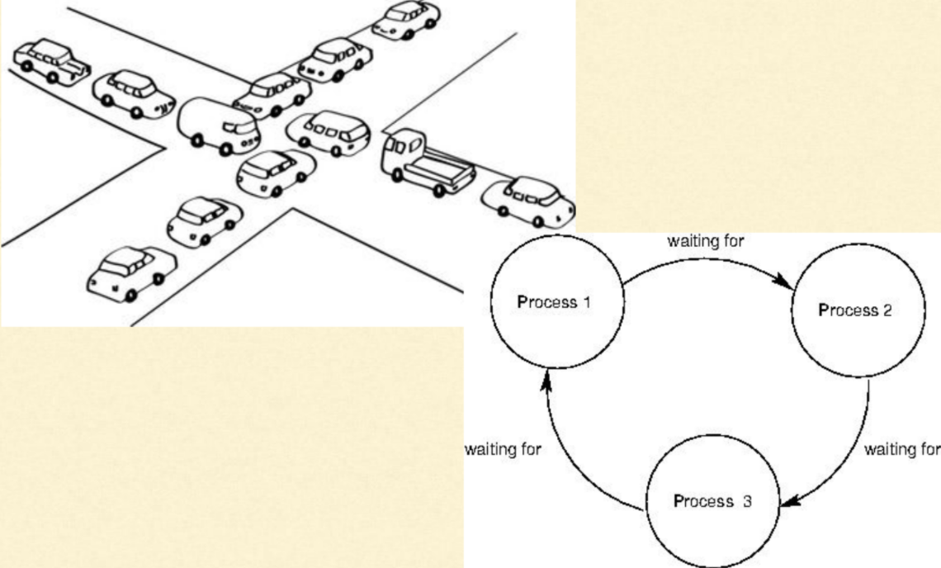
Race Condition

Slide 33
Race Condition
accounts[to] += amount;
This is not an atomic operation. Multiple steps are involved:
Load accounts[to] into a register.
Add amount.
Move the result back to accounts[to].

Slide 34
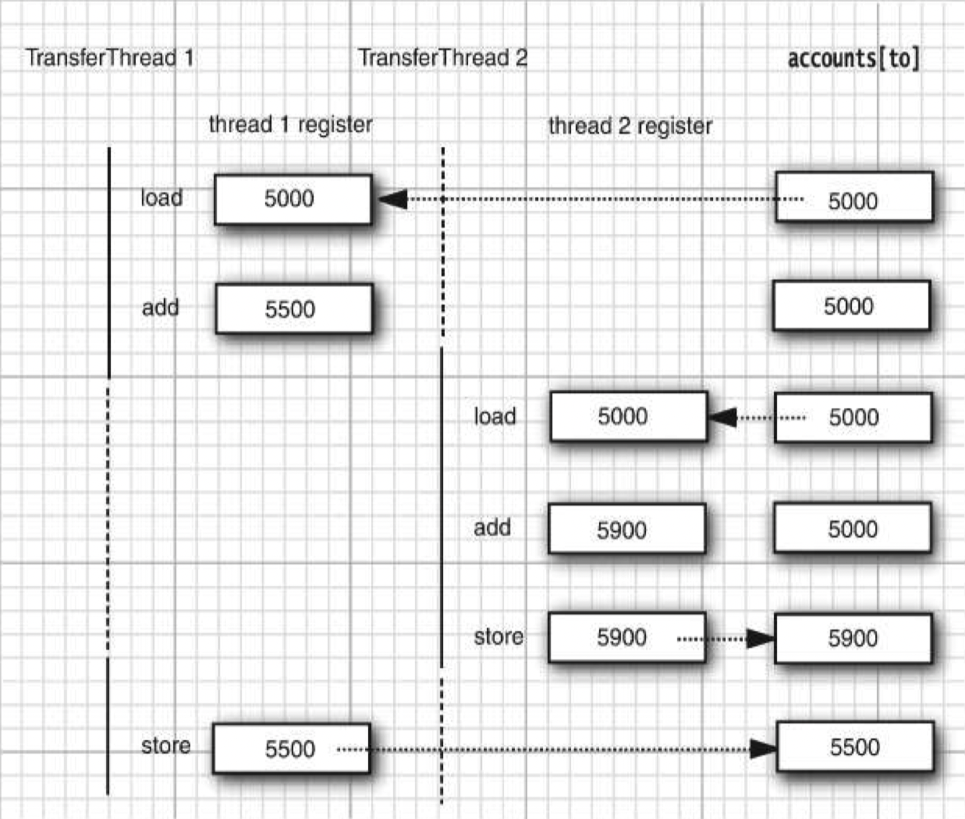
Race Condition
accounts[to] += amount;
This is not an atomic operation. Multiple steps are involved:
Load accounts[to] into a register.
Add amount.
Move the result back to accounts[to].

Slide 35
Synchronized vs. Unsynchronized Threads

Slide 36
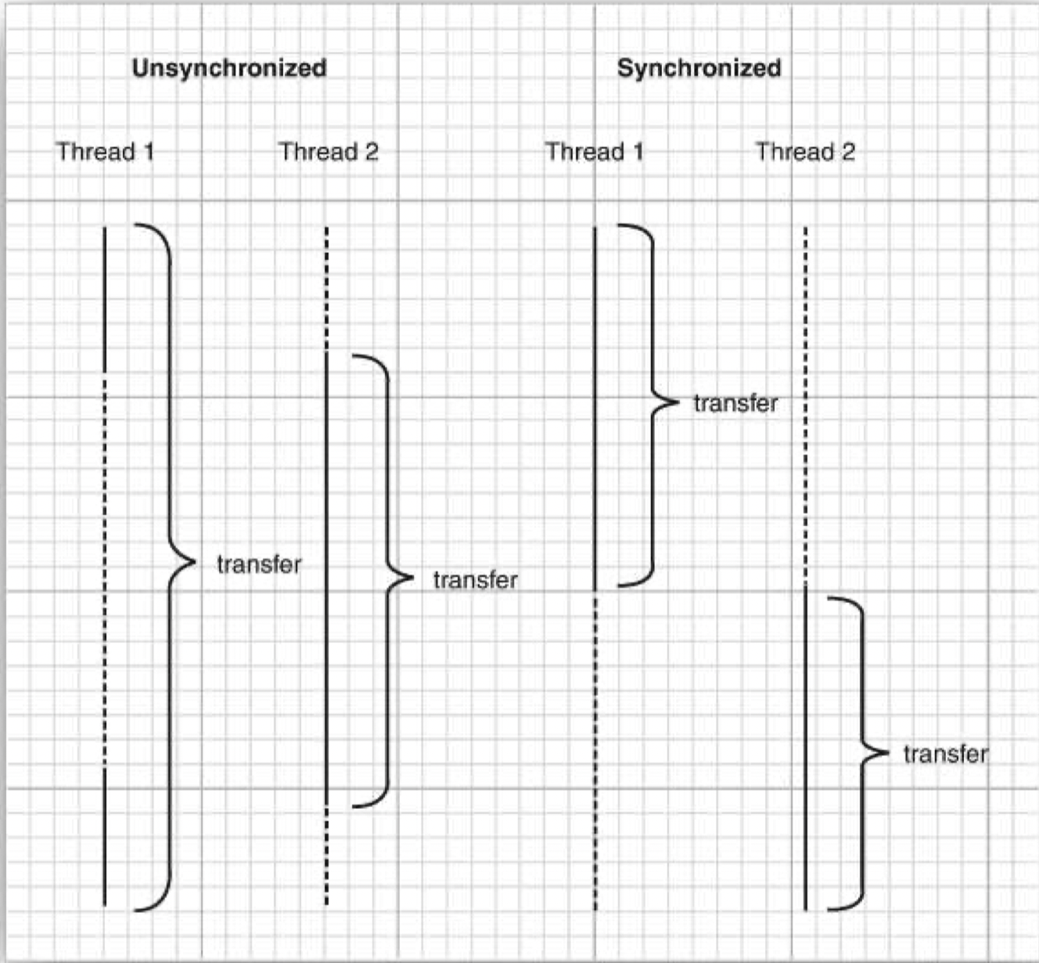
Synchronized vs. Unsynchronized Threads

Slide 37
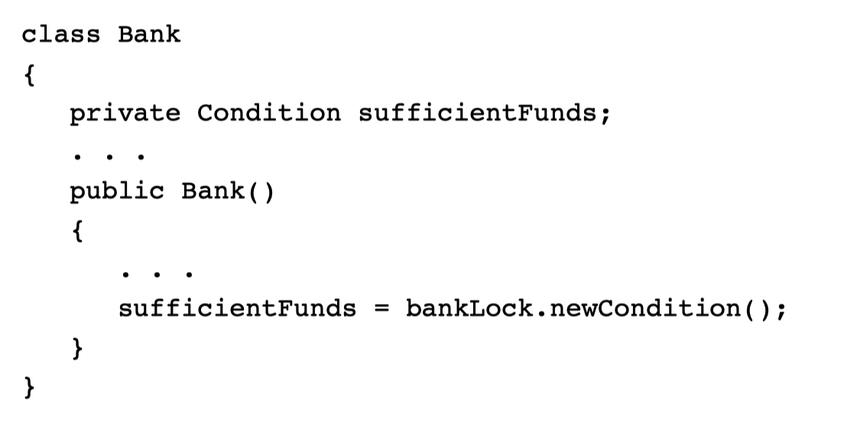
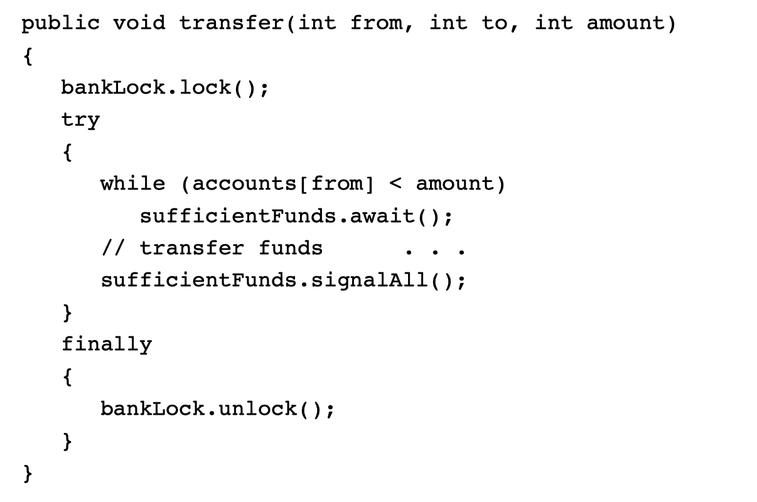
Creating Conditions

Slide 38
Locks and Conditions
A lock protects sections of code, allowing only one thread to execute the code at a time.
A lock manages threads that are trying to enter a protected code segment.
A lock can have one or more associated condition objects.
Each condition object manages threads that have entered a protected code section but that cannot proceed.

Slide 39
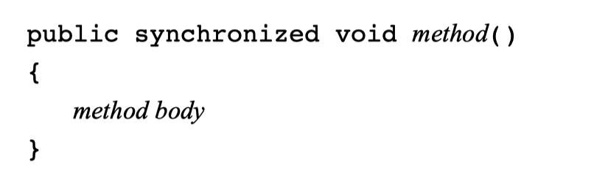
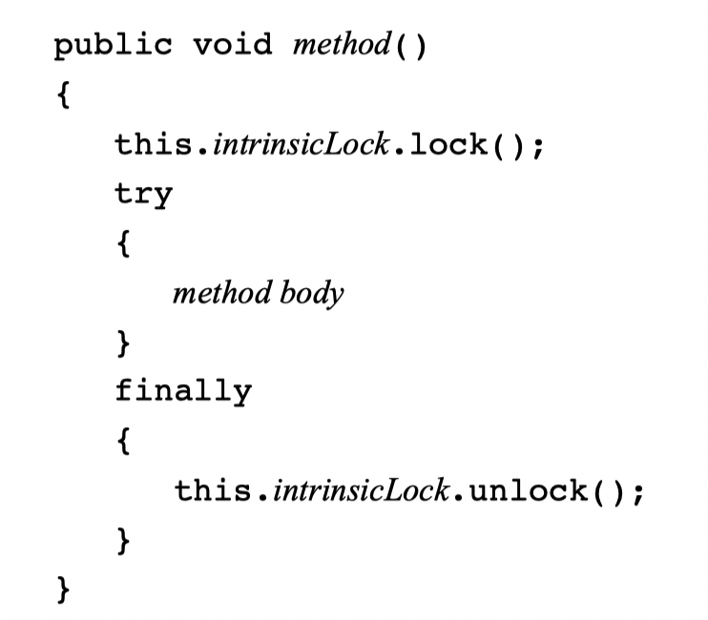
Synchronized Keyword

Slide 40
Limitations of Intrinsic Lock and Conditions
Cannot interrupt a thread that is trying to acquire a lock.
Cannot specify a timeout when trying to acquire a lock.
Having a single condition per lock can be inefﬁcient.

Slide 41
Synchronized Block
synchronized (obj) // this is the syntax for a synchronized block
{
critical section
}

Slide 42
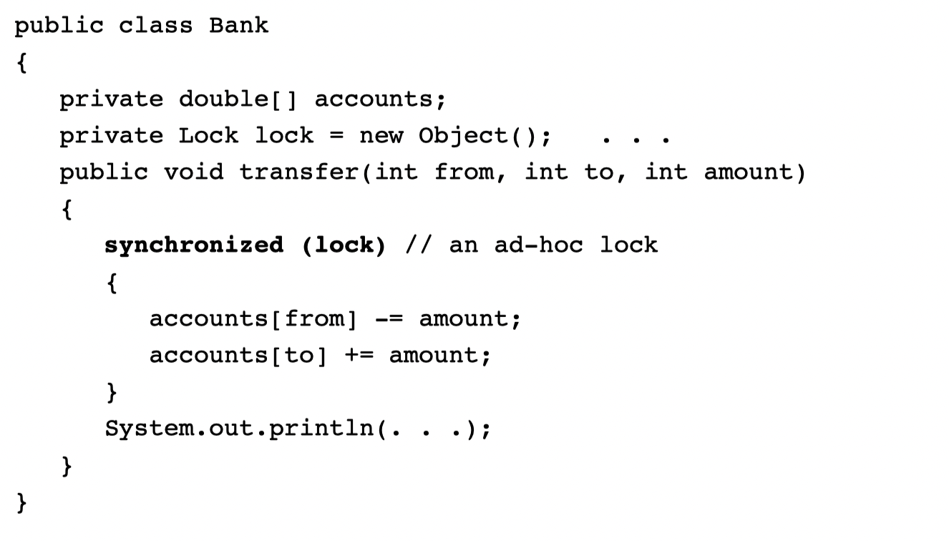
Synchronized Block

Slide 43
Synchronized Block
Careful about String Literal, Integer wrapper and static fields. Why???

Slide 44
Deadlocks

Slide 45
Deadlock
Account 1: $200
Account 2: $300
Thread 1: Transfer $300 from Account 1 to Account 2
Thread 2: Transfer $400 from Account 2 to Account 1

Slide 46
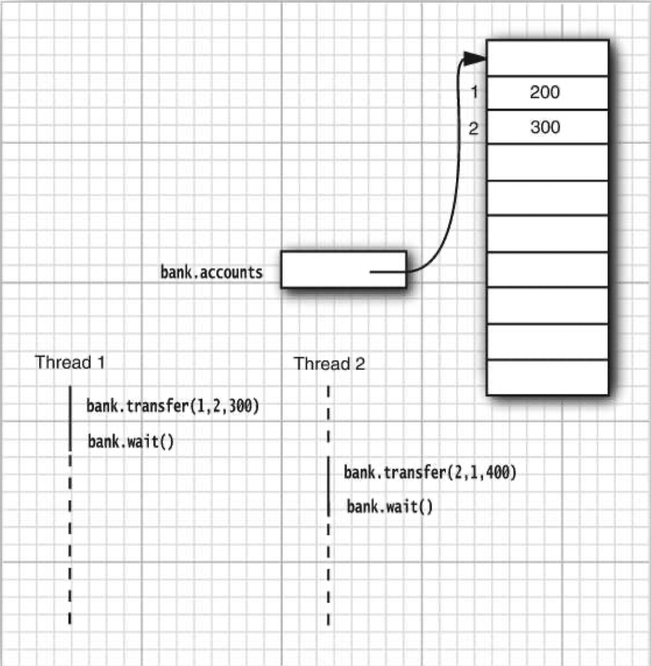
Deadlock

Slide 47
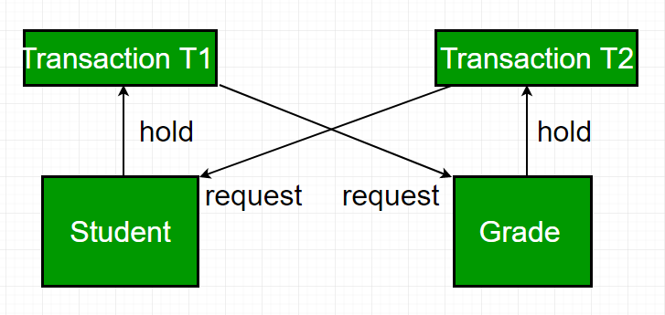
Deadlocks in Databases
A deadlock occurs in a multi-user database environment when two or more transactions block each other indefinitely by each holding a resource the other needs.
This results in a cycle of dependencies (circular wait) where no transaction can proceed.
In the image, we can see that:
T1 locks Resource "Student" and needs Resource "Grade"
T2 locks Resource "Grade" and needs Resource "Student"
T1 waits for T2, T2 waits for T1, hence resulting in a deadlock
Reference: https://www.geeksforgeeks.org/dbms/deadlock-in-dbms/

Slide 48
Long Running Tasks

Slide 49
Long Running Task in User Interfaces
JButton open = new JButton("Open");
open.addActionListener(event ->
{ // BAD--long-running action is executed on UI thread
Scanner in = new Scanner(file);
while (in.hasNextLine()) { String line = in.nextLine(); . . .
} });

Slide 50
Long Running Task in User Interfaces
JButton open = new JButton("Open");
open.addActionListener(event ->
{ // BAD--long-running action is executed on UI thread
Scanner in = new Scanner(file);
while (in.hasNextLine()) { String line = in.nextLine(); . . .
} });
open.addActionListener(event ->
{ // GOOD--long-running action in separate thread
Runnable task = () -> {
Scanner in = new Scanner(file);
while (in.hasNextLine()) {
String line = in.nextLine();
. . .
} };
executor.execute(task); });

Slide 51
Part III What’s Next

Slide 52
Next Lecture

Slide 53
Next lecture
Next lecture includes Guided Learning:
Code Completion Tools

Slide 54
Thank you!

Slide 55
Thank you!
Questions?
Dr. Andreas S. Maniatis
Assistant Professor
Andreas.Maniatis@UWindsor.ca
http://www.linkedin.com/in/andreasmaniatis

